Slide 1
Presentations on stack
Notes:
By Nguyen

Slide 2
Objectives
Stacks
Array-based stack
Stack implemented by a singly linked list
Stack class in java.util

Slide 3
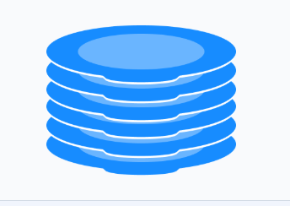

What is a stack?
A stack is a Last In, First Out (LIFO) data structure
Anything added to the stack goes on the “top” of the stack
Anything removed from the stack is taken from the “top” of the stack

Slide 4
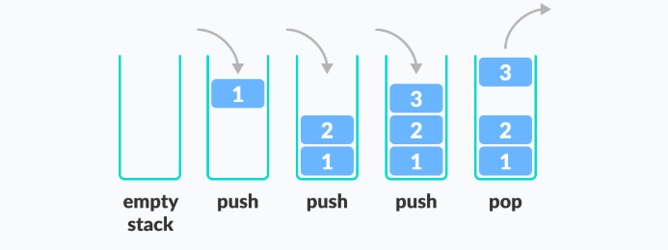
Operations on a stack

Slide 5
Operations on a stack
- clear() — Clear the stack
- isEmpty() — Check to see if the stack is empty
- push(el) — Put the element el on the top of the stack
- pop() — Take the top most element from the stack
- peek() — Return the top most element in the stack without removing it

Slide 6
Stack Exceptions
Exceptions are said to be “thrown” by an operation that cannot be executed
In the Stack ADT (Abstract Data Type) , operations pop and top cannot be performed if the stack is empty

Slide 7
Applications of Stacks
Stacks are used for:
Any sort of nesting (such as parentheses)
Evaluating arithmetic expressions (and other sorts of expression)
Keeping track of choices yet to be made (as in creating a maze)
Undo sequence in a text editor
Auxiliary data structure for algorithms

Slide 8
Stack in computer memory
How does a stack in memory actually work?
Each time a method is called, an activation record (AR) is allocated for it each new activation record is placed on the top of the run-time stack
When a method terminates, its activation record is removed from the top of the run-time stack
Thus, the first AR placed onto the stack is the last one removed

Slide 9
Array-based Stack - 1
A simple way of implementing the Stack ADT (abstract data type) uses an array
We add elements from left to right
A variable top keeps track of the index of the top element
…
S
0
1
2
top
Array-based stack

Slide 10
Array-based Stack - 2
The array storing the stack elements may become full
A push operation will then throw a FullStackException
Limitation of the array-based implementation
Not intrinsic to the Stack ADT
…
S
0
1
2
top
Array-based stack may become full

Slide 11
Implementing a stack using ArrayList & LinkedList classes in Java
import java.util.*;
class MyStack{
ArrayList h;
MyStack() {
h = new ArrayList();
}
boolean isEmpty(){
return(h.isEmpty());
}
void push(Object x){
h.add(x);
}
Object pop(){
if(isEmpty()) return(null);
return(h.remove(h.size()-1));
}
}
import java.util.*;
class MyStack{
LinkedList h;
MyStack() {
h = new LinkedList();
}
boolean isEmpty(){
return(h.isEmpty());
}
void push(Object x){
h.add(x);
}
Object pop(){
if(isEmpty()) return(null);
return(h.removeLast());
}
}

Slide 12
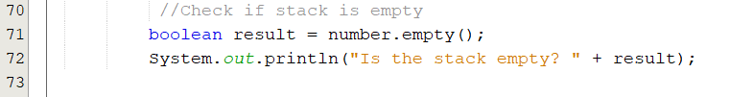
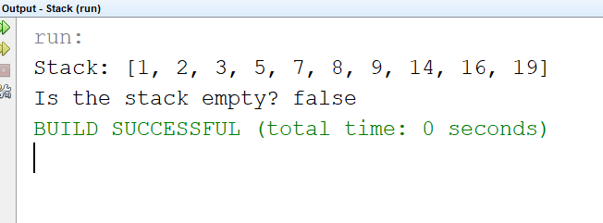
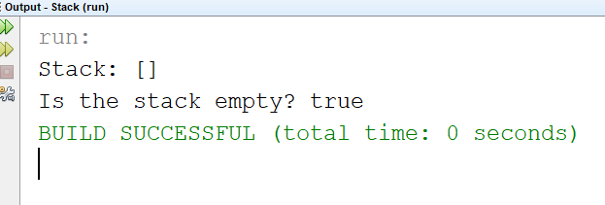
isEmpty
check if the stack is empty or not?

Slide 13
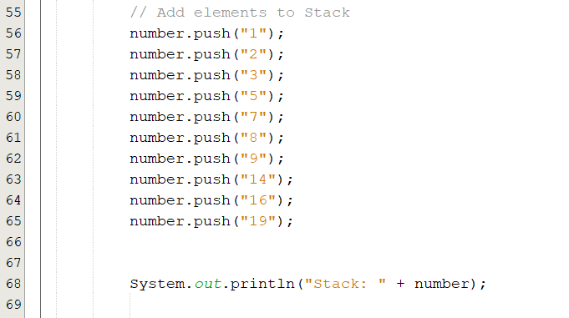
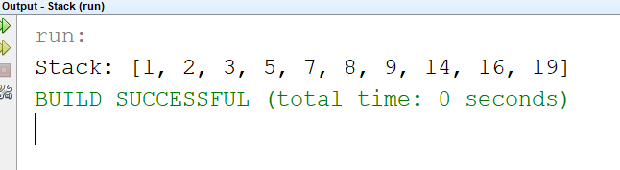
Push

Slide 14
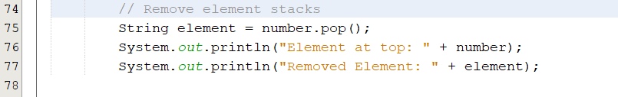
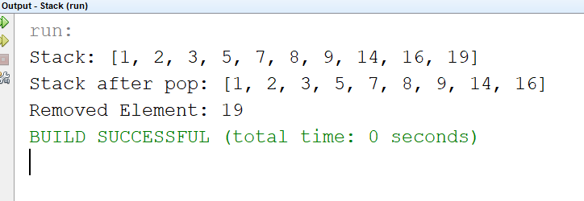
Pop

Slide 15
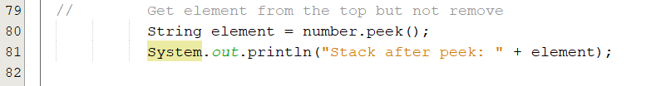
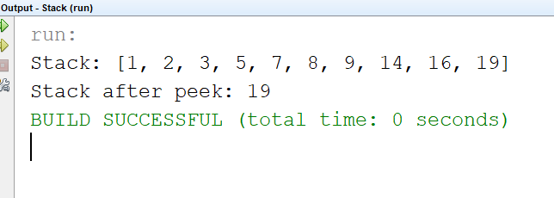
Peek

Slide 16
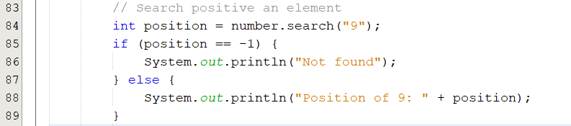
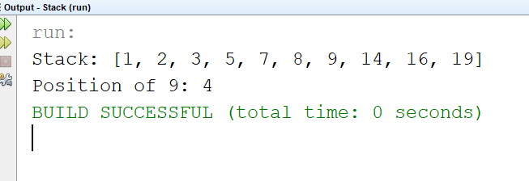
Search
search from right to left

Slide 17
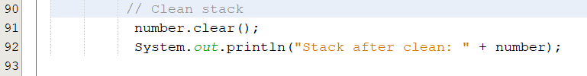
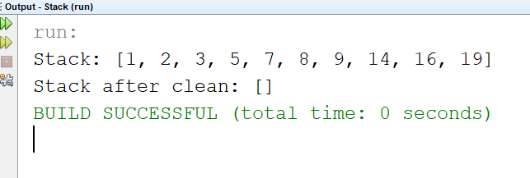
Clean

Slide 18
Array implementation
public class ArrayStack {
protected Object[] a;
int top, max;
public ArrayStack() {
this(50);
}
public ArrayStack(int max1) {
max = max1;
a = new Object[max];
top = -1;
}
protected boolean grow() {
int max1 = max + max / 2;
Object[] a1 = new Object[max1];
if (a1 == null) {
return (false);
}
for (int i = 0; i <= top; i++) {
a1[i] = a[i];
}
a = a1;
return (true);
}
public boolean isEmpty() {
return (top == -1);
}
public boolean isFull() {
return (top == max - 1);
}
public void clear() {
top = -1;
}
public void push(Object x) {
if (isFull() && !grow()) {
return;
}
a[++top] = x;
}
Object top() throws EmptyStackException {
if (isEmpty()) {
throw new EmptyStackException();
}
return (a[top]);
}
public Object pop() throws EmptyStackException {
if (isEmpty()) {
throw new EmptyStackException();
}
Object x = a[top];
top--;
return (x);
}
}

Slide 19
Linked implementation
class Node
{ public Object info;
public Node next;
public Node(Object x, Node p)
{ info=x; next=p; }
public Node(Object x)
{ this(x,null); }
};
Object top() throws EmptyStackException
{ if(isEmpty()) throw new EmptyStackException();
return(head.info);
}
public Object pop() throws EmptyStackException
{ if(isEmpty()) throw new EmptyStackException();
Object x = head.info;
head=head.next;
return(x);
}
class LinkedStack
{ protected Node head;
public LinkedStack()
{ head = null; }
public boolean isEmpty()
{ return(head==null);}
public void push(Object x)
{ head = new Node(x,head);
}

Slide 20
Convert decimal integer number to binary number
public class Main{
public static void decToBin(int k){
MyStack s = new MyStack();
System.out.print(k + " in binary system is: ");
while(k>0){
s.push(new Integer(k%2));
k = k/2;
}
while(!s.isEmpty())
System.out.print(s.pop());
System.out.println();
}
public static void main(String [] args)
{decToBin(11);
System.out.println();
}
}

Slide 21
Validate expression using stack - 1
We consider arithmetic expressions that may contain various pairs of grouping symbols, such as
• Parentheses: “(” and “)”
• Braces: “{” and “}”
• Brackets: “[” and “]”
The following examples further illustrate this concept:
• Correct: ( ) (( )) {([( )])}
• Correct: ((( )(( )) {([( )])}))
• Incorrect: )(( )){([( )])}
• Incorrect: ({[ ])}
• Incorrect: (

Slide 22
Validate expression using stack - 2
An Algorithm for Matching Delimiters:
An important task when processing arithmetic expressions is to make sure their delimiting symbols match up correctly. We can use a stack to perform with a single left-to-right scan of the original string.
Each time we encounter an opening symbol, we push that symbol onto the stack, and each time we encounter a closing symbol, we pop a symbol (assuming it is not empty) and check that these two symbols form a valid pair.

Slide 23
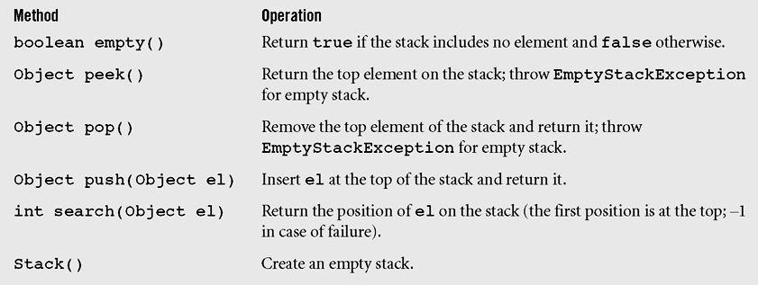
Stack class in Java
java.util package is an extension of class Vector
Stack class in Java

Slide 24
Summary
A stack is a linear data structure that can be accessed at only one of its ends for storing and retrieving data.
A stack is called an LIFO structure: last in/first out.

Slide 25


